Slide 1

Mobile Application Development
Welcome
Class: BS(CS)-VII
Sukkur IBA University – Kandhkot Campus
Week - 08
Lecture – 16
Your Facilitator, Adil Khan

Slide 2
Fragments

Slide 3
Fragments
A Fragment is a self-contained component with its own user interface (UI) and lifecycle that can be reused in different parts of an app's UI.
A Fragment is a class that contains a portion of an app's UI and behavior, which can be added as part of an Activity UI.
Each Fragment instance is exclusively tied to host Activity.
A Fragment is like a miniature Activity . Although it must be hosted by an Activity , a Fragment has its own lifecycle.

Slide 4
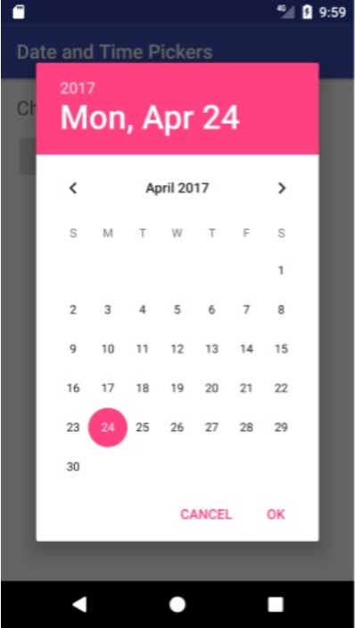
Fragments
Also like an Activity , a Fragment receives its own input events.
For example, the standard date picker is a Fragment —an instance of DialogFragment , a subclass of Fragment —that enables the user to input a date.
The standard date picker shows a dialog window floating on top of the Activity window.

Slide 5
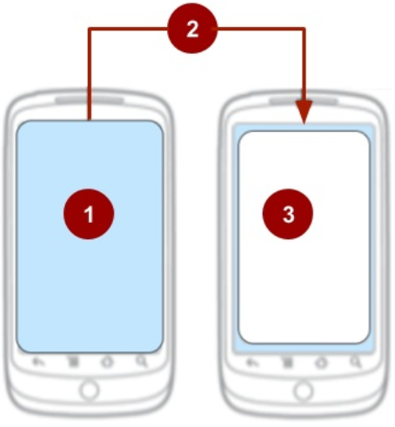
Fragments
For maximum reusability, a single Fragment should contain the code to define its layout and its behavior for user interaction.
In the figure on the right-side:
The Activity before the user event that adds the date picker.
A user event, such as clicking a button, adds the date picker to the UI of the Activity.
The date picker displays a dialog floating on top of the Activity.

Slide 6
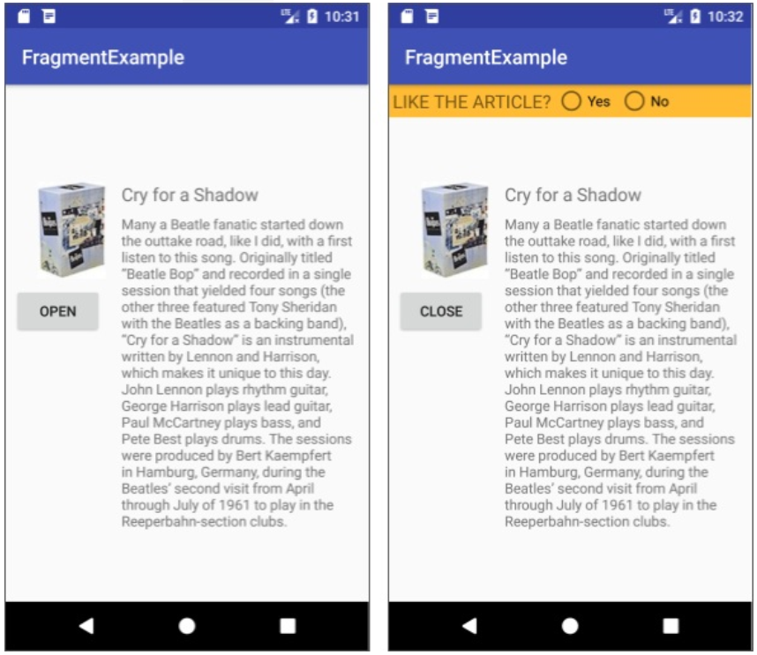
Fragments
A Fragment can be a static part of an Activity UI so that it remains on the screen during the entire lifecycle of the Activity.
Or it can be a dynamic part of the UI, added and removed while the Activity is running.
For example, the Activity can include buttons to open and close the Fragment.

Slide 7
Benefits of Fragments
Reuse a Fragment. Write the Fragment code once, and reuse the Fragment in more than one Activity without having to repeat code.
Add or remove dynamically as needed
Integrate a mini-UI within the Activity. Integrate a Fragment with an Activity UI or overlay the UI, so that the user can interact with the Fragment UI without leaving the Activity.

Slide 8
Benefits of Fragments
Retain data instances after a configuration change. Since a Fragment has its own lifecycle, it can retain an instance of its data after a configuration change (such as changing the device orientation).
Represent sections of a layout for different screen sizes. Encapsulating an interactive UI within a Fragment makes it easier to display the interactive UI on different screen sizes.

Slide 9
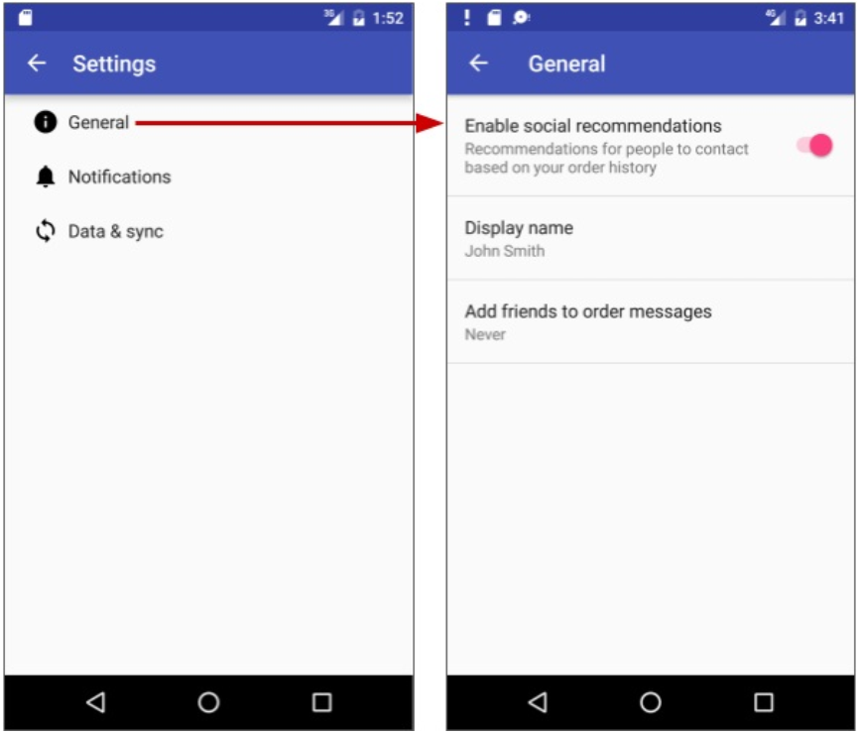
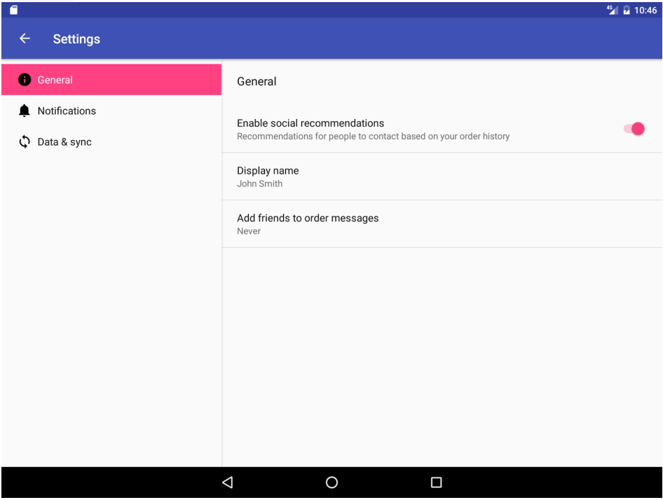
Example – Master-detail pane
On a Phone
On a Tablet PC
Master
Detail
Master
Detail

Slide 10
Steps for using a Fragment
Create a subclass of Fragment
Create a layout for the Fragment
Add Fragment to a host Activity
Statically in layout
Dynamically using fragment transactions

Slide 11
Creating a Fragment
To create a Fragment in an app, extend the Fragment class.
Instead of extending the base Fragment class, you can extend one of these other, more specific Fragment subclasses:
DialogFragment : Displays a floating dialog, such as a date picker or time picker.
ListFragment : Displays a list of items that are managed by an adapter (such as a SimpleCursorAdapter ).

Slide 12
Creating a Fragment
In Project: Android view, expand app > java and select the folder containing the Java code for your app.
Choose File > New > Fragment > Fragment (Blank).
Name the Fragment something like SimpleFragment.
Check the Create layout XML option if it is not already checked.

Slide 13
Creating a Fragment
Other options include:
Include fragment factory methods: Include sample factory method code to initialize the Fragment arguments in a way that encapsulates and abstracts them. Select this option if the number of arguments would make a constructor too complex.
Include interface callbacks: Select this option if you want to include sample code that defines an interface in the Fragment with callback methods that enable the Fragment to communicate with its host Activity.
5. Click Finish to create the Fragment

Slide 14
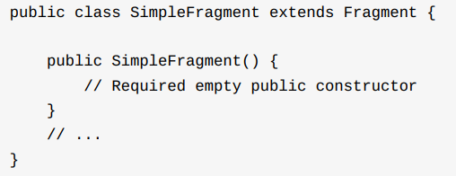
Creating a Fragment
If you named the Fragment SimpleFragment , the following code appears in the Fragment:

Slide 15
Creating a Fragment
All subclasses of Fragment must include a public no-argument constructor as shown, with the code public SimpleFragment().
The Android framework often re-instantiates a Fragment class when needed and this constructor is used by the framework for that.
This is why a Fragment is instantiated using a factory method newInstance() instead of using constructor

Slide 16

Creating a Fragment
In the Fragment class, you will create a static method like shown below to create and return a Fragment object:
And in the Activity class, you will instantiate the Fragment by calling the newInstance() method in SimpleFragment.

Slide 17
Create a layout for a Fragment
If you check the Create layout XML option when creating a Fragment, the layout file is created for you and named after the Fragment, for example "fragment_simple.xml" for SimpleFragment.
Similar to an Activity, a Fragment inflates its layout to make it appear on the screen.
Android calls the onCreateView() callback method to display a Fragment.
Override this method to inflate the layout for a Fragment, and return a View that is the root of the layout for the Fragment

Slide 18
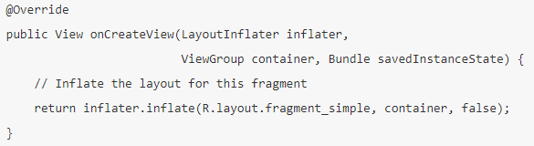
Create a layout for a Fragment
For example, if you chose Fragment (Blank) with just the Create layout XML option, and you name the Fragment SimpleFragment, the following code is generated in SimpleFragment:

Slide 19
Create a layout for a Fragment
The container parameter passed to onCreateView() is the parent ViewGroup from the Activity layout. Android inserts the Fragment layout into this ViewGroup.

Slide 20
Create a layout for a Fragment
The onCreateView() callback provides a LayoutInflater object to inflate the UI for the Fragment from the fragment_simple layout resource. The method returns a View that is the root of the layout for the Fragment.
The savedInstanceState parameter is a Bundle that provides data about the previous instance of the Fragment, in case the Fragment is resuming.

Slide 21

Create a layout for a Fragment
The inflate() method inside onCreateView() displays the layout:
It takes three arguments:
The resource ID of the layout you want to inflate (R.layout.fragment_simple).
The ViewGroup to be the parent of the inflated layout (container).
A boolean indicating whether the inflated layout should be attached to the ViewGroup (container) during inflation. This should be false because the system is already inserting the inflated layout into the container. Passing true would create a redundant ViewGroup in the final layout.

Slide 22
Adding a fragment to an activity
A Fragment must be hosted by an Activity and included in its layout. There are two ways you can use a Fragment in an Activity layout:
Add the Fragment statically, inside the XML layout file for the Activity, so that it remains on the screen during the entire lifecycle of the Activity.
For example, you may want to devote a portion of a UI for an Activity to a Fragment that provides its own user interaction and behavior, such as a set of social media "Like" buttons. You can add this Fragment to the layouts of different activities.
Add the Fragment dynamically, using fragment transactions. During the lifecycle of the Activity, your code can add or remove the Fragment.

Slide 23
Adding a fragment statically
Declare Fragment inside Activity layout (activity_main.xml) using <fragment> tag.
Specify layout properties for the Fragment as if it were a View.

Slide 24
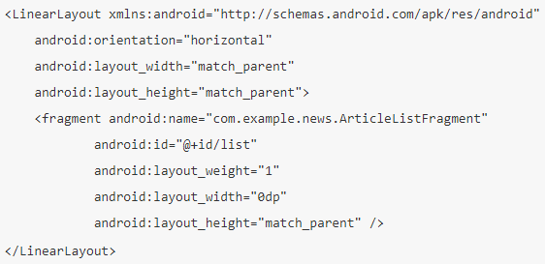
Adding a fragment statically

Slide 25
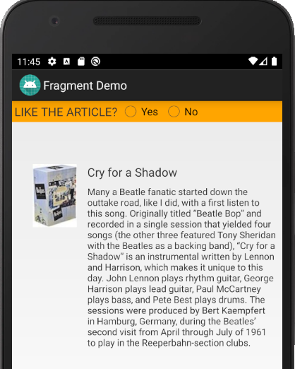
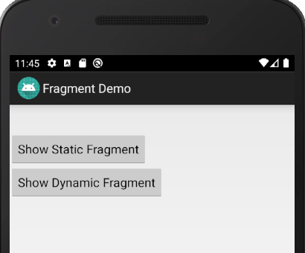
Adding a fragment statically - example

Slide 26
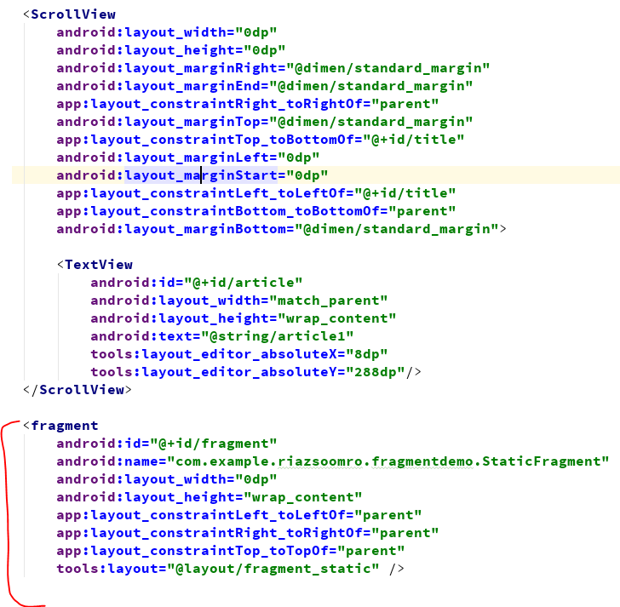
Adding a fragment statically - example

Slide 27
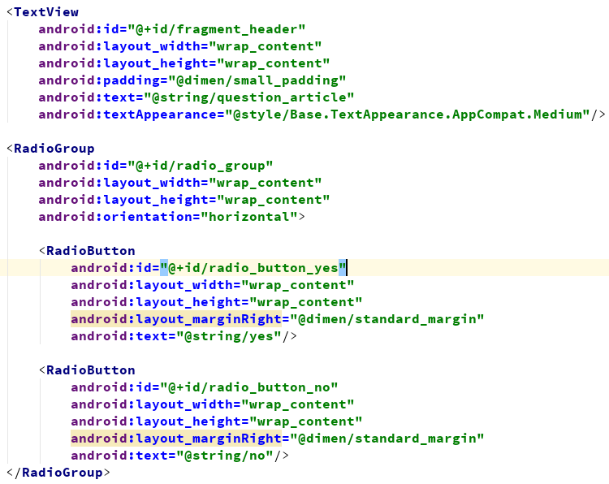
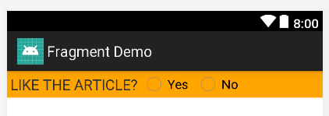
Adding a fragment statically - example

Slide 28
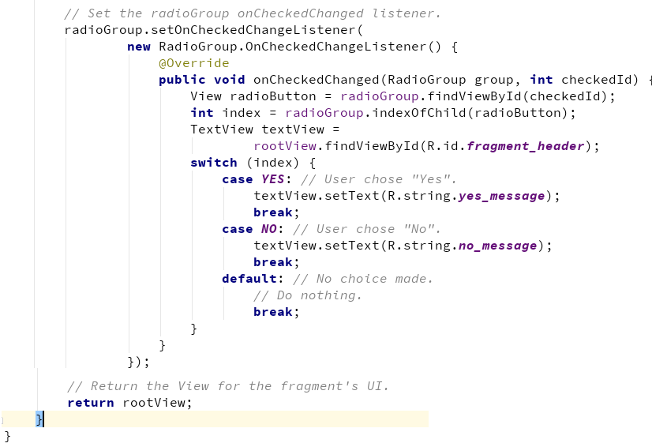
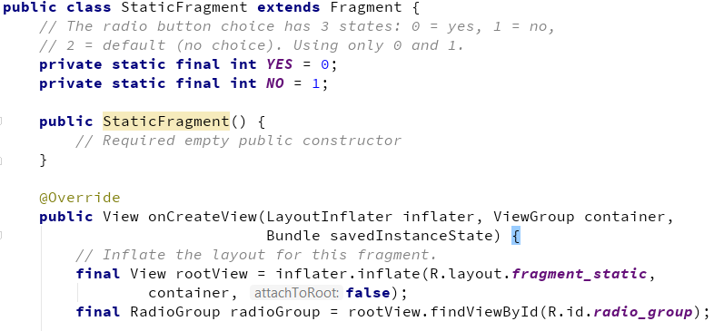
Adding a fragment statically – Fragment Class

Slide 29
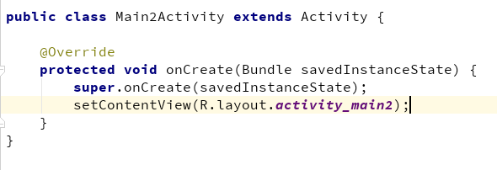
Adding a fragment statically – Activity Class
In Activity, we have just inflated the layout. Nothing more than that.

Slide 30
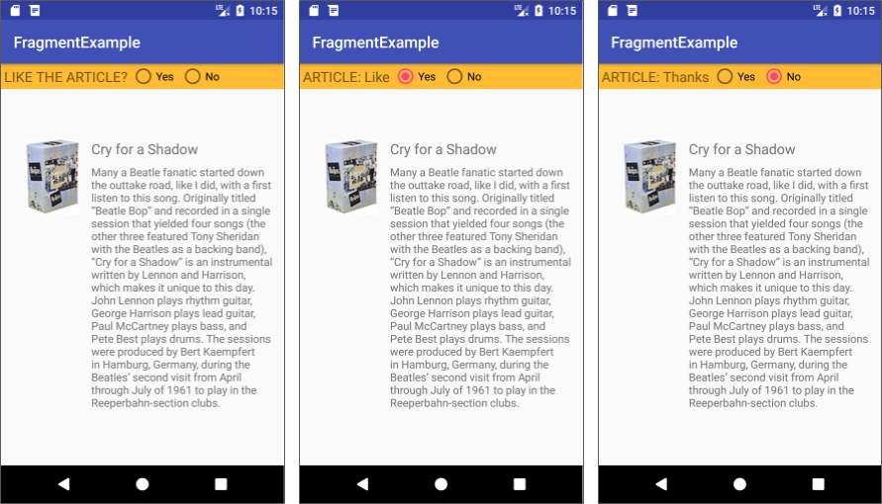
Adding a fragment statically - Output

Slide 31
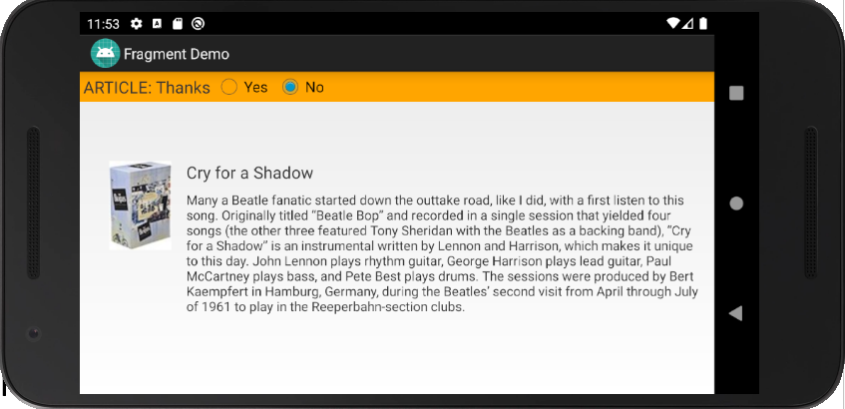
Adding a fragment statically - example
After tapping a radio button, change the orientation of your device or emulator from portrait to landscape. Note that the "Yes" or "No" choice is still selected.

Slide 32
Adding a fragment statically - example
Switching the device orientation after choosing "No" demonstrates that a Fragment can retain an instance of its data after a configuration change (such as changing the orientation).
This feature makes a Fragment useful as a UI component, as compared to using separate Views.
While an Activity is destroyed and recreated when a device's configuration changes, a Fragment is not destroyed.

Slide 33
Adding a fragment dynamically
Specify ViewGroup for Fragment in layout
Instantiate the Fragment in Activity
Instantiate FragmentManager
Use Fragment transactions

Slide 34
Adding a fragment dynamically
A great feature of the Fragment class is the ability to add, remove, or replace a Fragment dynamically, while an Activity is running.
A user performs an interaction in the Activity, such as tapping a button, and the Fragment appears in the UI of the Activity. The user taps another button to remove the Fragment.
To add a Fragment, your Activity code needs to specify a ViewGroup as a placeholder for the Fragment, such as a LinearLayout or a FrameLayout.

Slide 35
Adding a fragment dynamically
<LinearLayout xmlns:android="http://schemas.android.com/apk/res/android"
android:id="@+id/fragment_container"
android:name="SimpleFragment"
android:orientation="horizontal"
android:layout_width="match_parent"
android:layout_height="match_parent"
app:layout_constraintLeft_toLeftOf="parent"
app:layout_constraintRight_toRightOf="parent"
app:layout_constraintTop_toTopOf="parent"
tools:layout="@layout/fragment_simple">
</LinearLayout>

Slide 36
Adding a fragment dynamically
To manage a Fragment in your Activity, create an instance of the Fragment, and an instance of FragmentManager.
With FragmentManager you can use FragmentTransaction methods to perform Fragment operations while the Activity runs.

Slide 37
Instantiate the Fragment
Create newInstance() factory method in Fragment:
public static SimpleFragment newInstance() {
return new SimpleFragment();
}
2. In Activity, instantiate Fragment by calling newInstance():
SimpleFragment fragment = SimpleFragment.newInstance();

Slide 38
Instantiate FragmentManager
In Activity, get instance of FragmentManager with getFragmentManager():
FragmentManager fragmentManager = getFragmentManager();

Slide 39
Use Fragment transactions
Fragment operations are wrapped into a transaction:
Start transaction with beginTransaction()
Do all Fragment operations (add, remove, etc.)
End transaction with commit()

Slide 40
Fragment transaction operations
Add a Fragment using add()
Remove a Fragment using remove()
Replace a Fragment with another using replace()
Hide and show a Fragment using hide() and show()

Slide 41
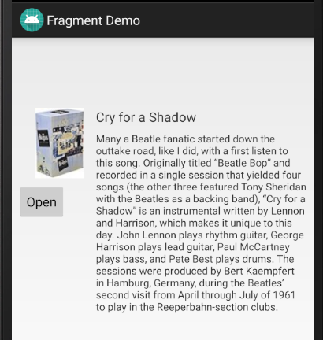
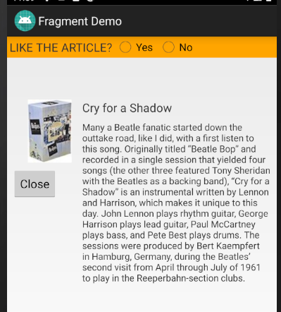
Use Fragment transactions - example
Here, a button is given in the app.
When the user taps that button, the Fragment will show/appear, and the text of the button changes to “Close”.
Then when a user taps it, the Fragment will be closed/disappeared.

Slide 42
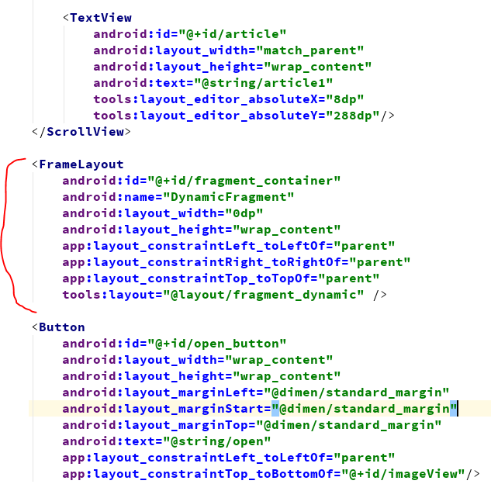
Use Fragment transactions - example

Slide 43
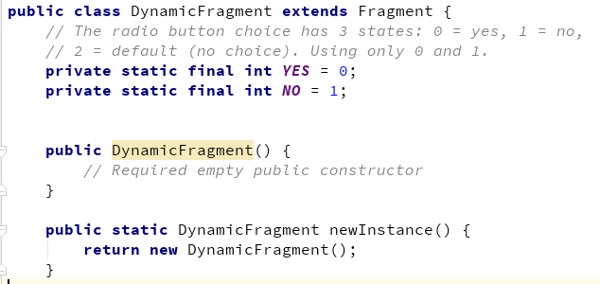
Use Fragment transactions – Fragment Class

Slide 44
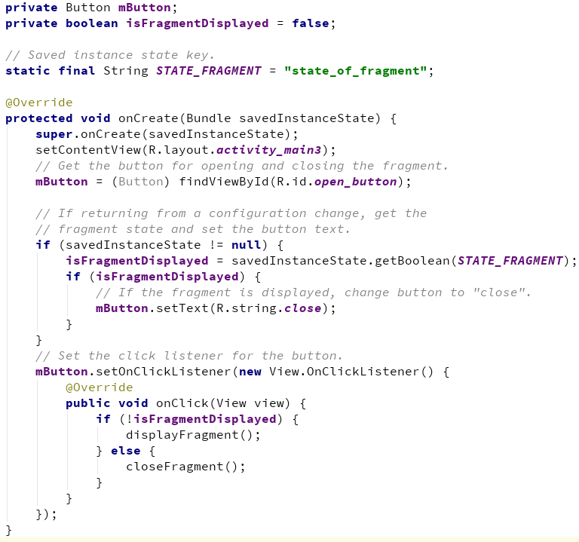
Use Fragment transactions – Activity Class

Slide 45
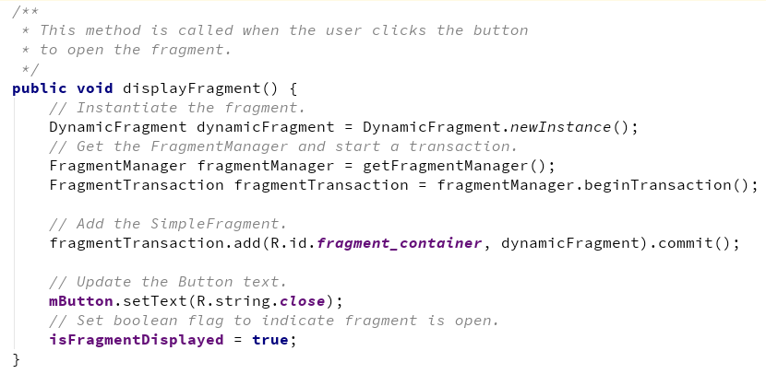
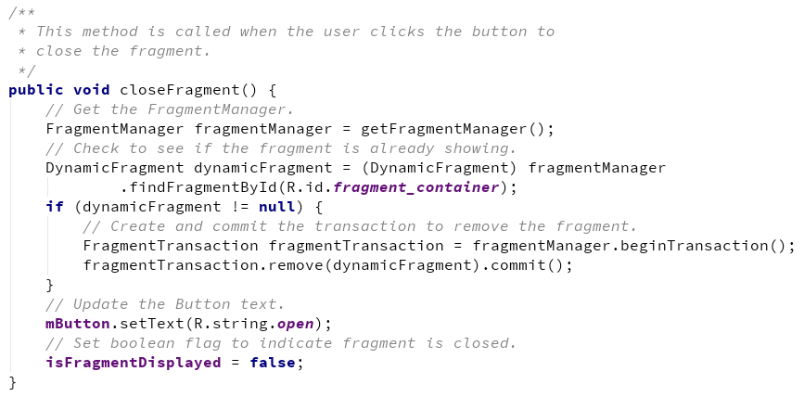
Use Fragment transactions – Activity Class

Slide 46
Thank you!
Any Questions???

